Slide 1
Genetic Incompatibility Lab
BIO 240L Spring 2023
Tyler Gandee, Dr. Karen Barnard-Kubow, Caylin Murray,
Dr. Alfredo López-Caamal, and Dr. Laura Galloway
Notes:
Slides from: Using Nanopore sequencing to assemble and compare chloroplast genomes: introducing genomics and bioinformatics into the classroom. Tyler Gandee, Caylin Murray, Alfredo Lopez-Caamal, Isobel Cobb, Laura F. Galloway, Joseph A. Harsh, Karen B. Barnard-Kubow. Nanopore related slides (slides 23-26) are taken from Oxford Nanopore Technologies’ Educational Slide Deck.

Slide 2
Learning objectives
Understand the concepts of speciation, reproductive isolation, genetic incompatibility, and how they are related
Understand the structure and function of organelle genomes
Be able to compare short versus long read high-throughput sequencing and know for which purposes each would be used.

Slide 3

How do new species form?
Santiago Ramierz Barahona

Slide 4
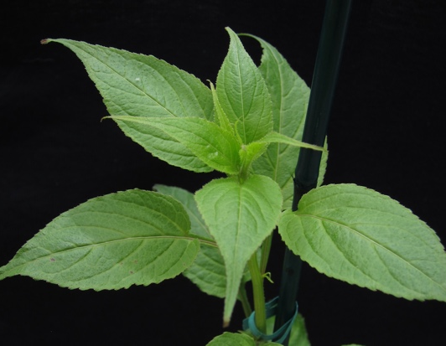
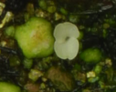
Speciation as a gradual accumulation of genetic incompatibility and thus reproductive isolation
What are the ecological and evolutionary processes that drive this process?

Slide 5
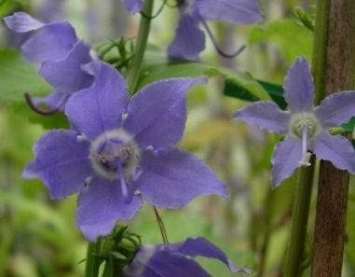
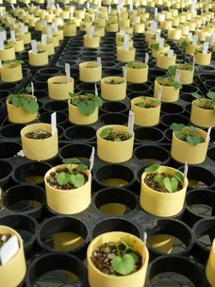
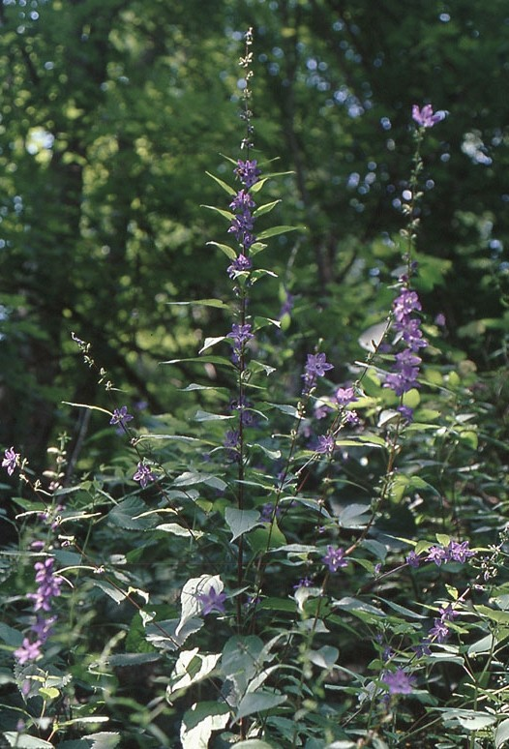
Campanula americana
(American Bellflower)
Notes:
Change to Campanula americana

Slide 6

Western
Western
Western
Appalachian
X
X

Slide 7

Appalachian
Western
Western
Appalachian

Slide 8
Eukaryotic cells contain not just a nuclear genome
Also contain one or more organelle genomes
Mitochondria
Chloroplast
M
C
Aa Bb

Slide 9
Cytonuclear co-evolution
Co-adaptation
M
C
Respiration
☺
Photosynthesis
Aa Bb
☺

Slide 10
Nuclear versus organelle genomes
Nuclear
Biparentally inherited
From mom and dad
Linear chromosomes
Larger genome size
Organelle
Uniparentally inherited
Often only from mom
Circular genome
Smaller genome size

Slide 11

Appalachian
Western
Western
Appalachian
What changes in the chloroplast genome cause this genetic incompatibility?
☺
☹

Slide 12
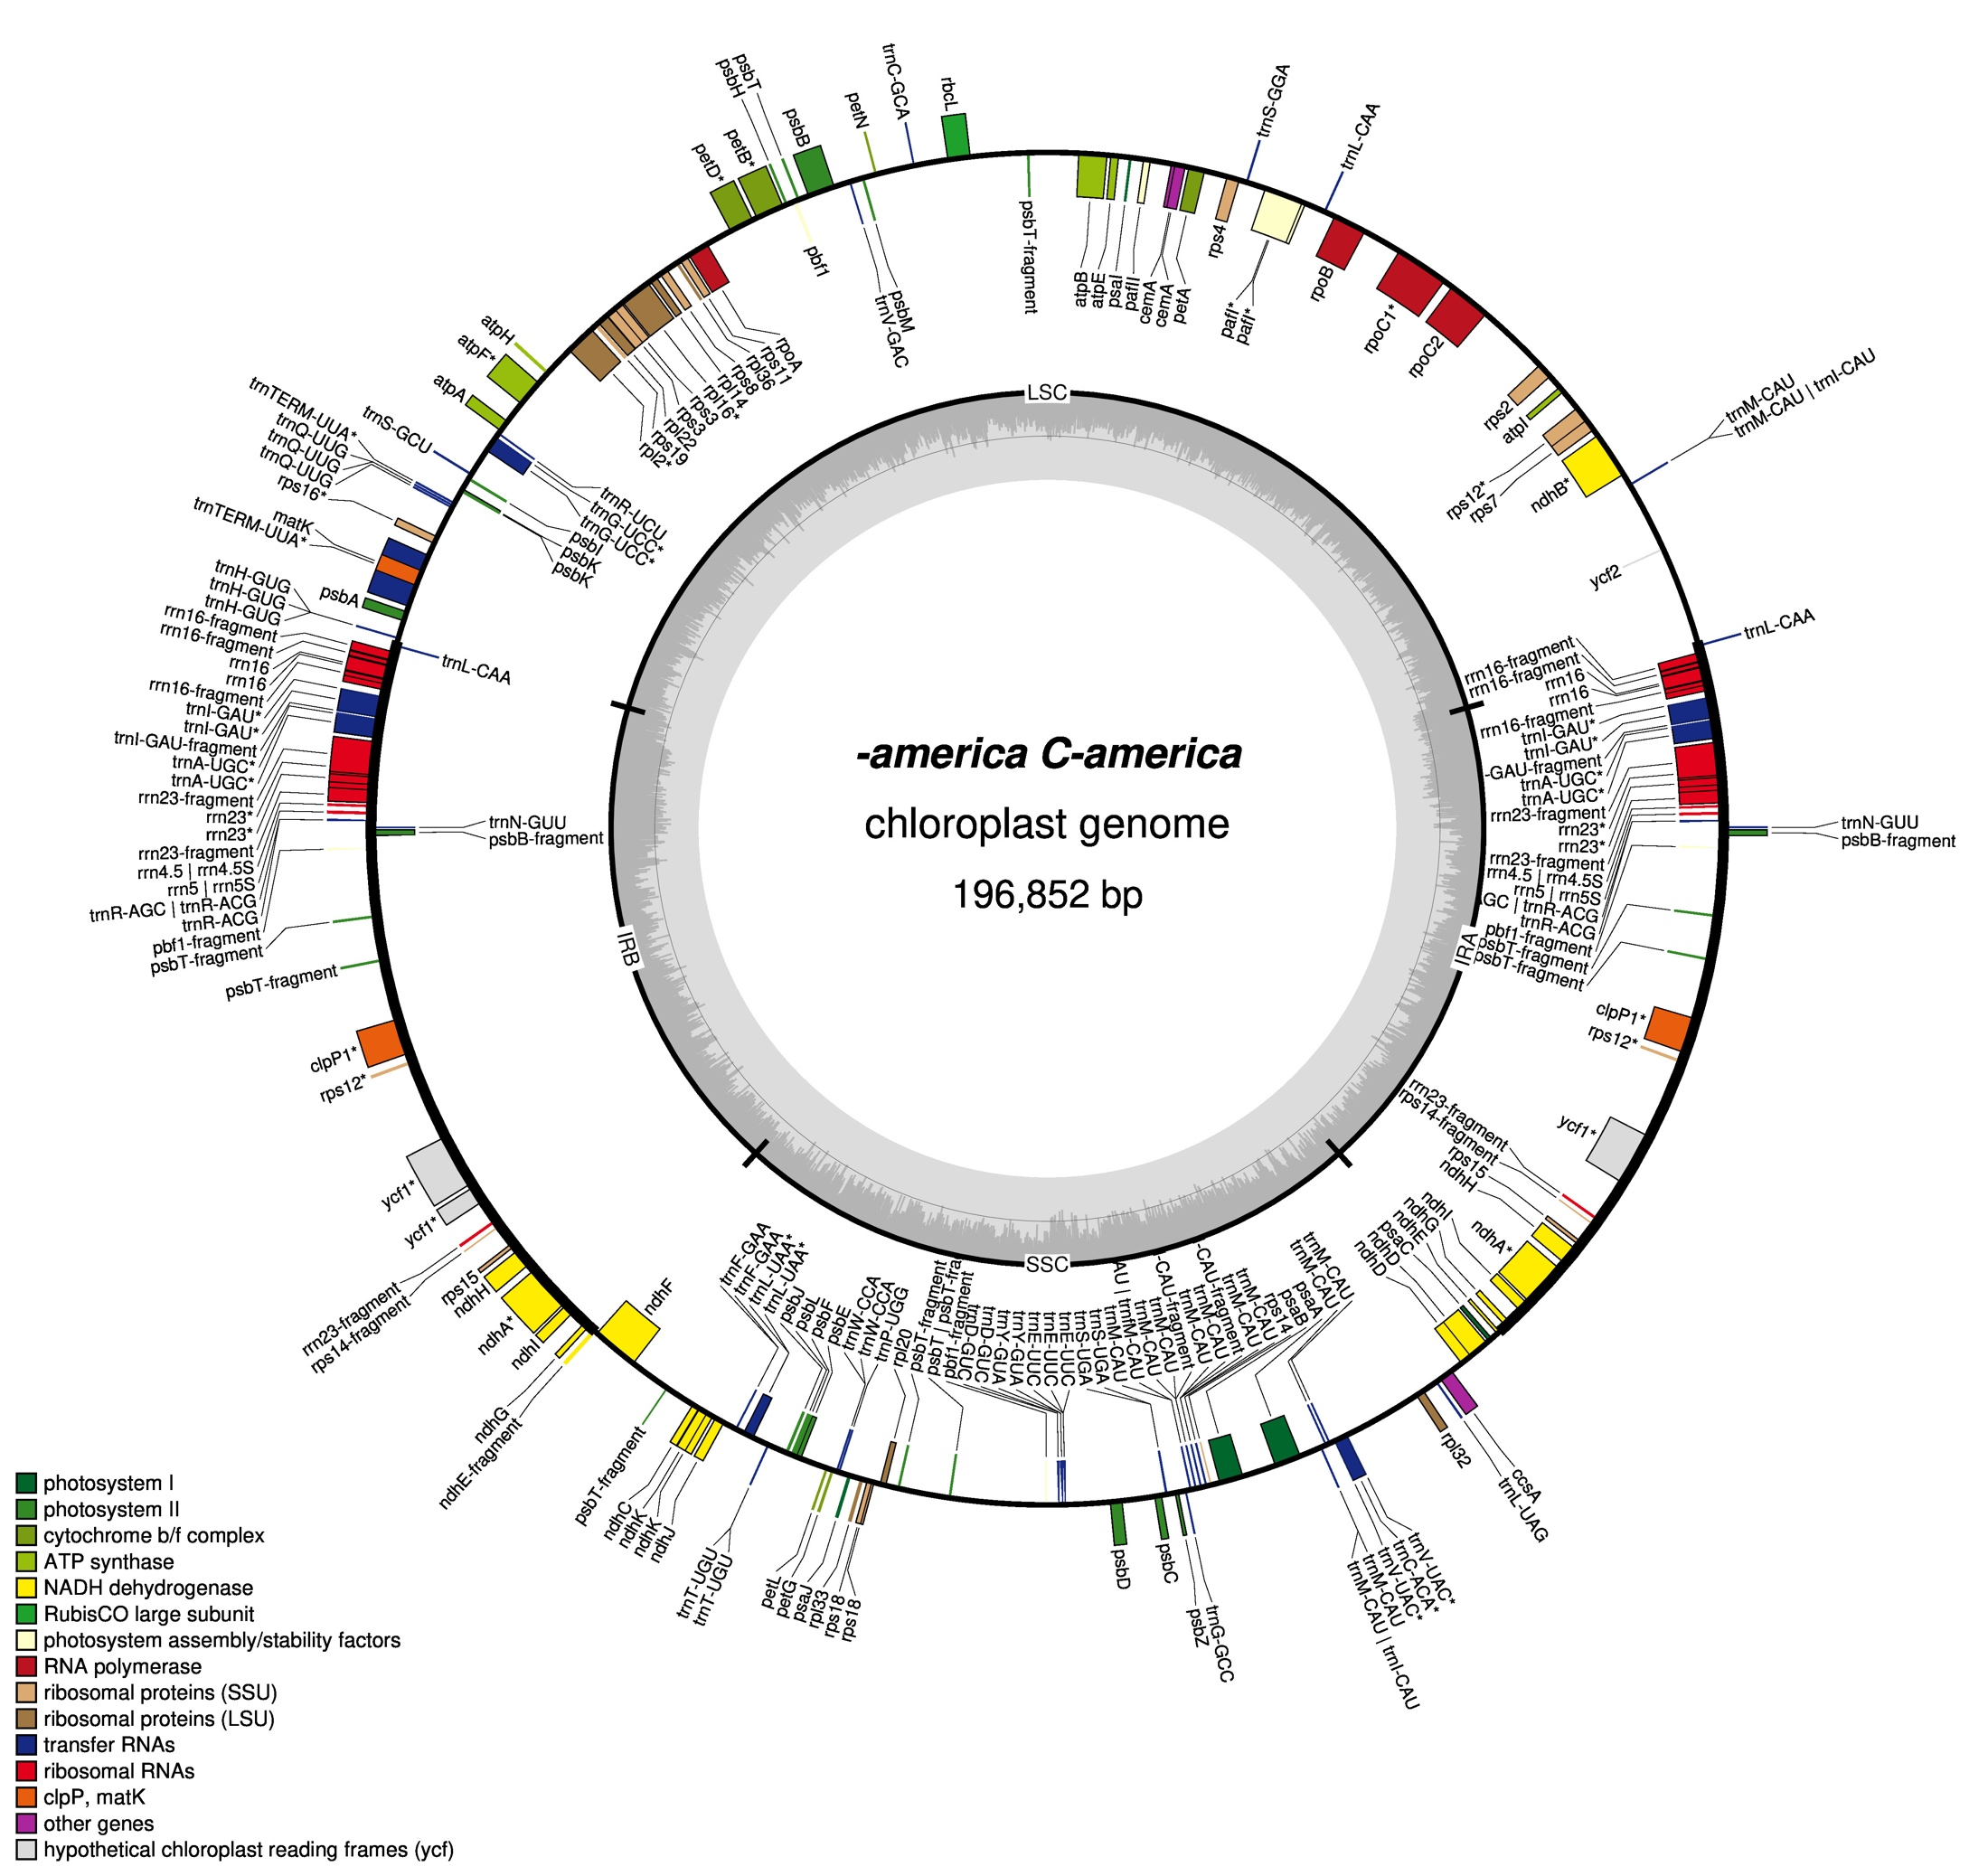
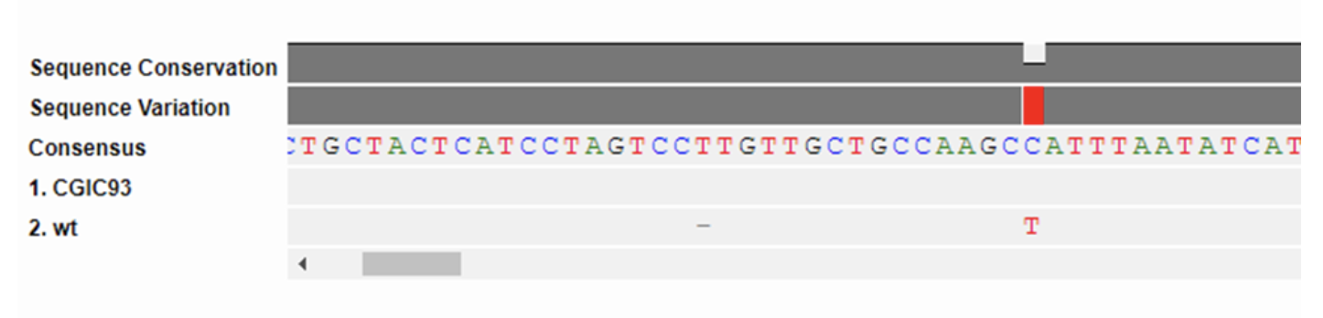
Types of genetic variation that could contribute to genetic incompatibility
Sequence level – point mutations
SNPs – single nucleotide polymorphisms
ATGCTAGTC
ATGGTAGTC
Campanula americana
Structural
Indels – insertions and deletions
Duplications
Inversions
Expansions/contractions of repetitive DNA

Slide 13
Genetic incompatibility in C. americana
Crossing between chloroplast lineages leads to reduced survival
Survival
r² = 0.87 ***
Expected
Reproductive Isolation
Barnard-Kubow et. al. 2016, Evolution

Slide 14
Types of genetic variation
Sequence level – point mutations
SNPs – single nucleotide polymorphisms
ATGCTAGTC
ATGGTAGTC
Structural
Indels – insertions and deletions
Duplications
Inversions
Expansions/contractions of repetitive DNA
Appears to be related to genetic incompatibility
What about this?
How do we find out?

Slide 15
Is there a relationship between extent of structural variation in the chloroplast genome in C. americana and strength of genetic incompatibility?
Our approach
Cross plants from different genetic lineages
Germinate the seeds and score the strength of genetic incompatibility
Extract DNA from the parental plants and sequence the full chloroplast genome
Assemble the chloroplast genome de-novo
Compare de-novo assemblies from parental plants to score number of structural variants
Graph strength of genetic incompatibility against number of structural variants to determine if there is a relationship

Slide 16
Is there a relationship between extent of structural variation in the chloroplast genome in C. americana and strength of genetic incompatibility?
Our approach
Cross plants from different genetic lineages
Germinate the seeds and score the strength of genetic incompatibility
Extract DNA from the parental plants and sequence the full chloroplast genome
Assemble the chloroplast genome de-novo
Compare de-novo assemblies from parental plants to score number of structural variants
Graph strength of genetic incompatibility against number of structural variants to determine if there is a relationship

Slide 17
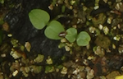
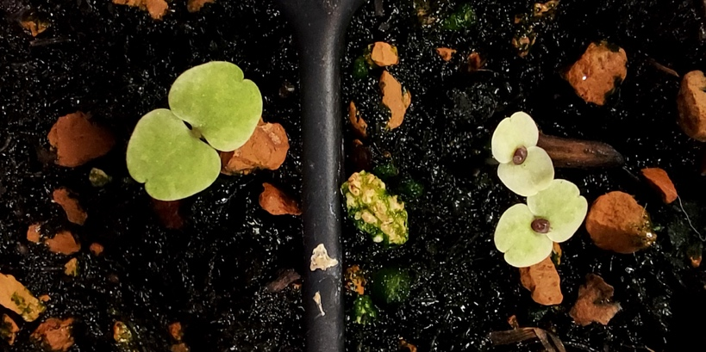
Scoring genetic incompatibility
Three types of crosses
Western x Eastern
Eastern x Appalachian
Western x Appalachian
Plant seeds on agar plates – last week
Score phenotypes – next class
Gemination – yes/no
Seedlings - green vs yellow vs white

Slide 18
Is there a relationship between extent of structural variation in the chloroplast genome in C. americana and strength of genetic incompatibility?
Our approach
Cross plants from different genetic lineages
Germinate the seeds and score the strength of genetic incompatibility
Extract DNA from the parental plants and sequence the full chloroplast genome
Assemble the chloroplast genome de-novo
Compare de-novo assemblies from parental plants to score number of structural variants
Graph strength of genetic incompatibility against number of structural variants to determine if there is a relationship

Slide 19
What kind of sequencing technology should we use to examine structural variation in the chloroplast genome?

Slide 20
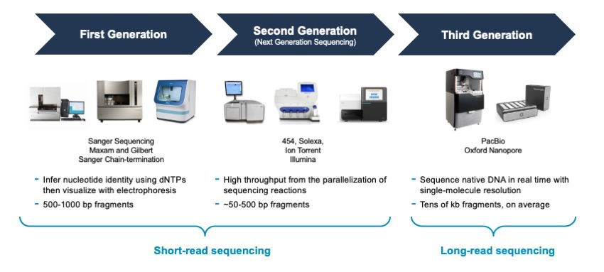
High-throughput sequencing
Lowest error rate, “gold standard”
Low throughput
Fairly low error rate
Highest throughput
Higher error rate
High throughput

Slide 21
Types of genetic variation – how do we identify these?
Sequence level – point mutations
SNPs – single nucleotide polymorphisms
ATGCTAGTC
ATGGTAGTC
Structural
Indels – insertions and deletions
Duplications
Inversions
Repetitive sequence
Short-read high-throughput sequencing
High sequence accuracy
Short read length
Long-read high-throughput sequencing
Lower sequence accuracy
Long read length

Slide 22
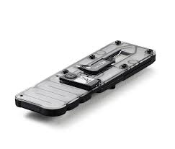
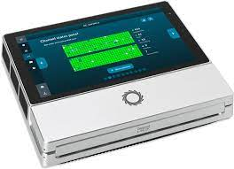
Our approach – Long-read high throughput sequencing to sequence the chloroplast genome
Nanopore’s Minion Sequencer
Nanopore’s Rapid Barcoding library prep
Load and sequence on a Minion flow cell

Slide 23
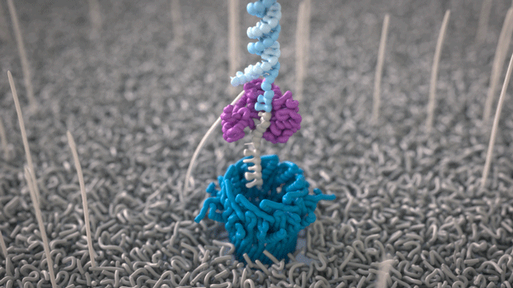
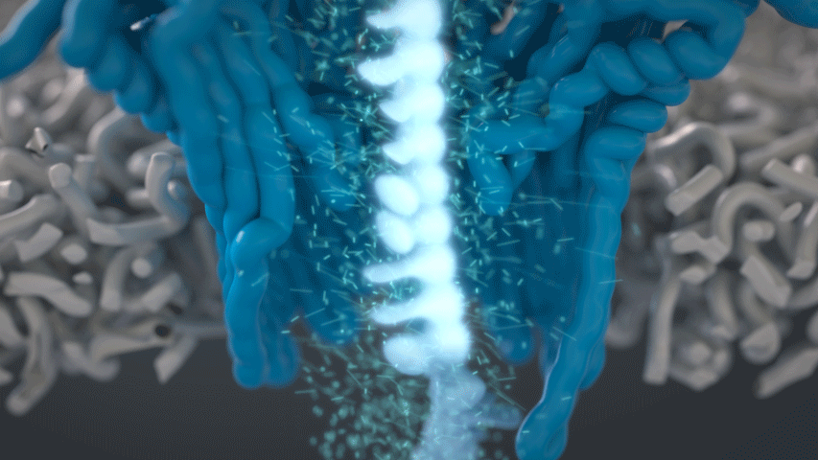
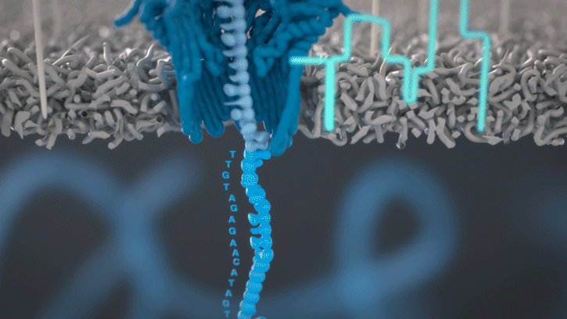

How nanopore sequencing works
1.
A motor feeds DNA through a nanopore
2.
The DNA blocks the flow of current through the pore
3.
The changes in current are decoded into the DNA sequence – this is called basecalling
Watch the full video on how nanopore sequencing works
Notes:
Slide from Oxford Nanopore Technologies
Teaching points:
A nanopore sits in a membrane, DNA is fed through
The DNA blocks an electrical current depending on what base is present in the pore
This digital method of reading DNA sequence has multiple benefits
NOTE – either slide 1 or 2 could be used to explain this

Slide 24
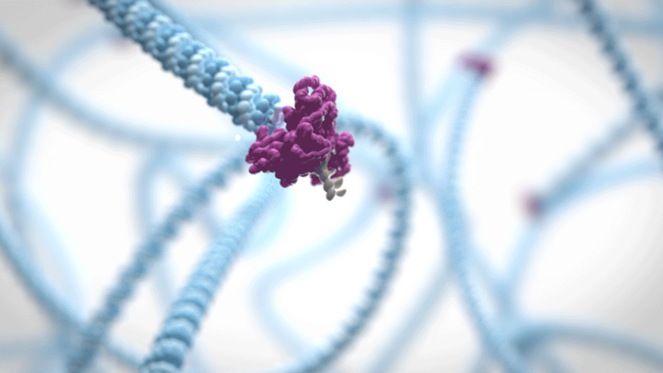
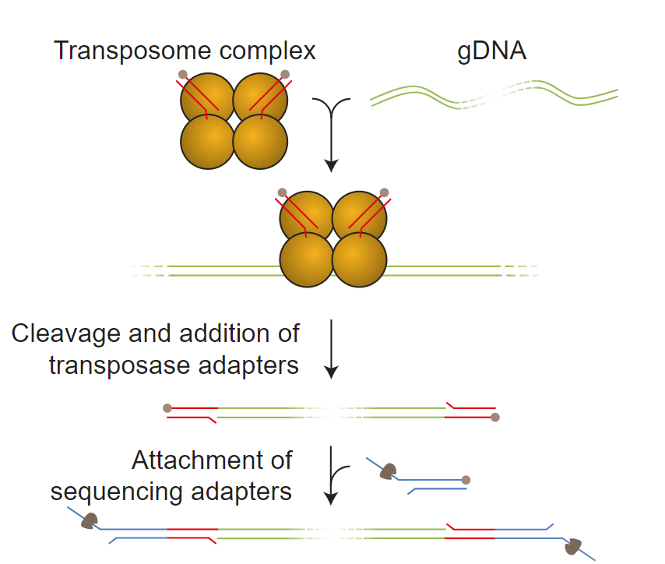
Preparing DNA for nanopore sequencing
Enzyme complex
DNA
1. Cuts DNA
2. Adds “glue”
DNA strand
Adapters with motor protein added to the end
Motor protein
Moves the DNA through the pore
3. “Sticks” on adapters
Notes:
Slide from Oxford Nanopore Technologies
Teaching points:
DNA must be prepared for sequencing by adding an adapter, containing a motor protein
The motor protein (a helicase) is responsible for controlling the movement of DNA through the pore
The “rapid” approach to library preparation uses a transposase to chop up DNA and add special chemical groups that can then be stuck to these adapters

Slide 25
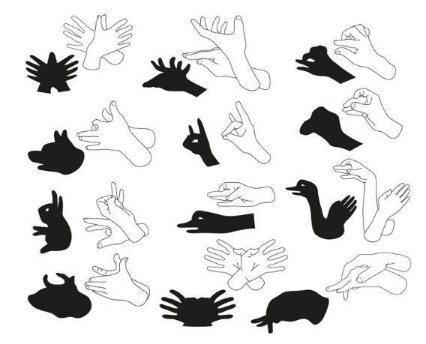
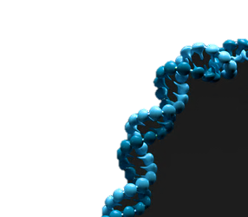
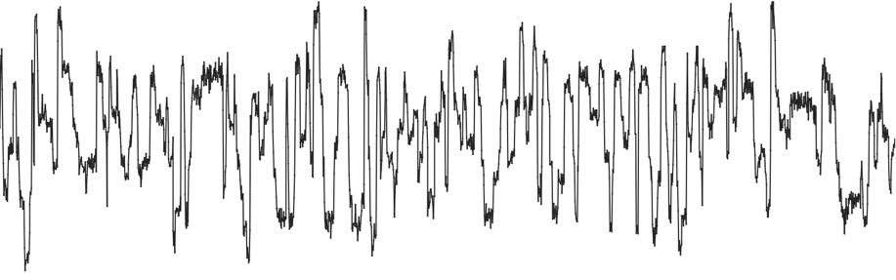
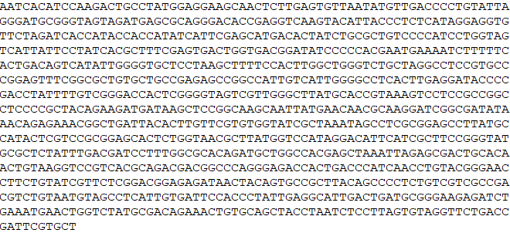
How does basecalling of nanopore data work?
The shadow puppet analogy
DNA…
…into current…
The hands block the light
Because the hands are a certain shape, it creates a shadow we recognise
Each base of DNA blocks the current
Because the bases are a certain shape and size, it creates a signal we can recognise
…and the current into bases
Notes:
Slide from Oxford Nanopore Technologies
Teaching points:
The shadow puppets show how blocking light leads to an obvious signal – the shape of the shadow produced
Nanopore sequencing operates on the same principle, but relies on blocking an electrical current with bases. The obvious signal is the amount of current blocked

Slide 26
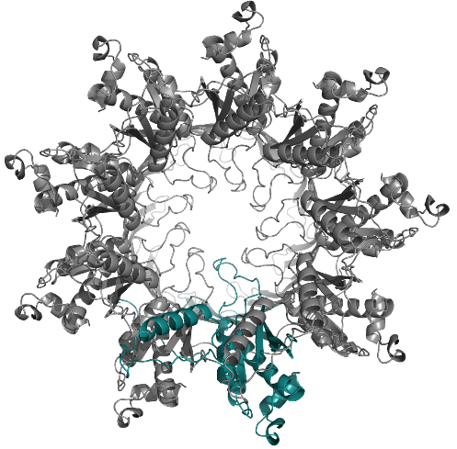
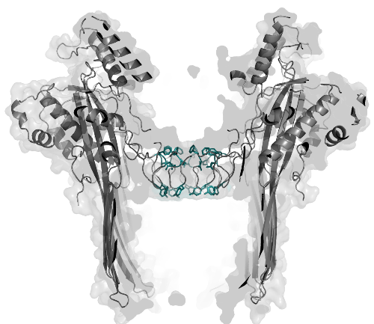
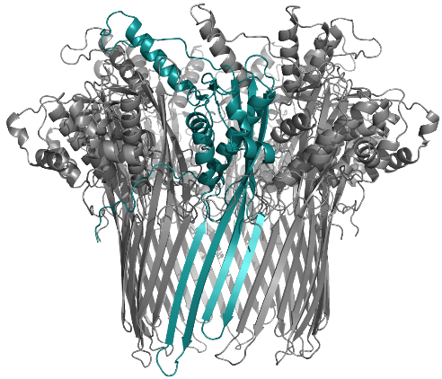
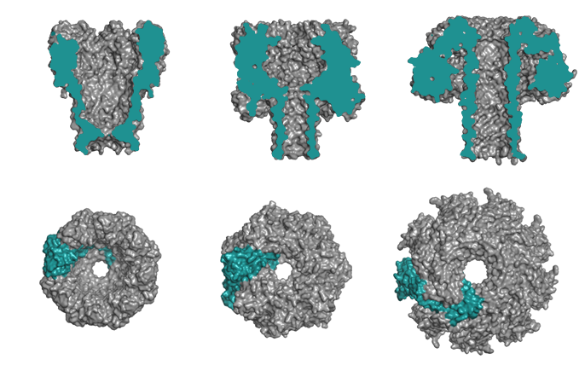

Where do nanopores come from?
They exist in nature but are engineered for nanopore sequencing
This is the CsgG pore
A nine-subunit protein from the outer membrane of E.coli
In nature it facilitates excretion of amyloid proteins for biofilms
Lots of nanopore families exist
They exhibit different structures
They may be useful for different applications
Read more about CsgG
Notes:
Slide from Oxford Nanopore Technologies
Teaching points:
Protein nanopores exist naturally and have multiple differing functions
The CsgG nanopore is used to transport proteins across the E.coli membrane, for example
Whatever nanopore is used can be engineered to optimise its signal, through classic molecular biology techniques utilising the central dogma of DNA → RNA → Proteins

Slide 27
https://nanoporetech.com/support/how-it-works#fullVideo&modal=fullVideo

Slide 28
Is there a relationship between extent of structural variation in the chloroplast genome in C. americana and strength of genetic incompatibility?
Our approach
Cross plants from different genetic lineages
Germinate the seeds and score the strength of genetic incompatibility
Extract DNA from the parental plants and sequence the full chloroplast genome
Assemble the chloroplast genome de-novo
Compare de-novo assemblies from parental plants to score number of structural variants
Graph strength of genetic incompatibility against number of structural variants to determine if there is a relationship

Slide 29
What relationship do you expect?
Strength of genetic incompatibility
Number of structural variants

